Slide 1
Chapter 2 Making & Using Objects

Slide 2
Outline
Introduce enough C++ syntax and program construction concepts to allow you to write and run some simple object-oriented programs.
C++ preprocessor instructions

Slide 3
The process of language translation
Interpreters
An interpreter translates source code into activities and immediately executes those activities.
Interpreter is a virtual machine that can run high-level programming language.
Advantages：
Cross-platform
Ease of interaction and rapid development
interpreter may introduce unacceptable speed restrictions

Slide 4
The process of language translation
Compilers
A compiler translates source code directly into assembly language or machine instructions.
Advantages
Performance
C++
Java

Slide 5
Java Compilation Process
Java Source
JavaC
Class File
Jvm

Slide 6
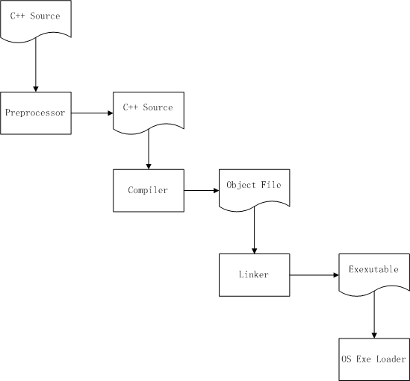
C++ compilation process

Slide 7
Hello.cpp
#include <iostream>
using namespace std;
int main(void) {
cout << "hello c++ world";
return 0;
}

Slide 8
Hello.java
public class HelloJava {
public static void main(String[] args) {
System.out.println("hello java world");
}
}

Slide 9
Demo
Compile a java source and a c++ source
Java
Javac
C++
预处理：
g++ -E main.cpp –stdlib=libstdc++
汇编：
g++ -S main.cpp –stdlib=libstdc++
编译：
g++ -c main.cpp –stdlib=libstdc++
预处理,编译,连接
g++ main.cpp –stdlib=libstdc++
Notes:
C:\Documents\course\oop\oop2013\Chapter 2\Compile

Slide 10
3/8

Slide 11
目标文件与连接
连接器把由编译产生的目标模块（一般是带”.o”或”.obj”扩展名的文件）连接成为操作系统可以加载和执行的程序。

Slide 12
Declarations vs. definitions
declaration(声明) ：
A declaration introduces a name – an identifier – to the compiler.
definition(定义) ：
A definition, on the other hand, says: “Make this variable here” or “Make this function here.”

Slide 13
Declarations vs. definitions
Function declaration
int func1(int,int);
int func1(int length, int width);
Function definition
int func1(int length, int width){……}

Slide 14
Declarations vs. definitions
Variable declaration
extern int i;
Variable definition
int i;

Slide 15
Static type checking
The compiler performs type checking during the first pass
Type checking tests for the proper use of arguments in functions and prevents many kinds of programming errors.
dynamic type checking
Some object-oriented languages (notably Java) perform some type checking at runtime .Even it is casted at compile time, the type is still checked at runtime.

Slide 16
示例：Stream
#include <iostream>
using namespace std;
int main() {
// Specifying formats with manipulators:
cout << "a number in decimal: "
<< dec << 15 << endl;
cout << "in octal: " << oct << 15 << endl;
cout << "in hex: " << hex << 15 << endl;
cout << "a floating-point number: "
<< 3.14159 << endl;
cout << "non-printing char (escape): "
<< char(27) << endl;
} ///:~
a number in decimal: 15
in octal: 17
in hex: f
a floating-point number: 3.14159
non-printing char (escape):

Slide 17
示例：字符串
#include <string>
#include <iostream>
using namespace std;
int main() {
string s1, s2; // Empty strings
string s3 = "Hello, World."; // Initialized
string s4("I am"); // Also initialized
s2 = "Today"; // Assigning to a string
s1 = s3 + " " + s4; // Combining strings
s1 += " 8 "; // Appending to a string
cout << s1 + s2 + "!" << endl;
} ///:~
Hello, World. I am 8 Today!

Slide 18
示例：C文件复制
FILE *in_file, *out_file;
char data[BUF_SIZE];
size_t bytes_in, bytes_out;
in_file = fopen(argv[1], "rb");
out_file = fopen(argv[2], "wb");
while ( (bytes_in = fread(data, 1, BUF_SIZE, in_file)) > 0 ) { bytes_out = fwrite(data, 1, bytes_in, out_file); if ( bytes_in != bytes_out ) { perror("Fatal write error.\n"); return 1; } }
fclose(in_file); fclose(out_file);

Slide 19
示例：C++文件复制
int main() {
ifstream in("Scopy.cpp"); // Open for reading
ofstream out("Scopy2.cpp"); // Open for writing
string s;
while(getline(in, s)) // Discards newline char
out << s << "\n"; // ... must add it back
} ///:~

Slide 20
示例：Vector
int main() {
vector<string> v;
ifstream in("Fillvector.cpp");
string line;
while(getline(in, line))
v.push_back(line); // Add the line to the end
for(int i = 0; i < v.size(); i++)
cout << i << ":" << v[i] << endl;
} ///:~

Slide 21
字符串连接
//: C02:Concat.cpp
// Character array Concatenation
#include <iostream>
using namespace std;
int main() {
cout << "This is far too long to put on a "
"single line but it can be broken up with "
"no ill effects\nas long as there is no »
"punctuation separating adjacent character »
"arrays.\n";
} ///:~

Slide 22
头文件
头文件用于声明目标文件或库文件中定义的变量或者函数。
包含头文件的语法：
#include <stdio.h>
#include “local.h”
#include <iostream>
三种包含头文件方式的区别

Slide 23
预处理
编译器编译C++程序时，它做的第一件事是进入预处理阶段。
预处理指令可以认为是独立于C++的一种程序设计语言，使用预处理指令编写的程序有时又被称为元程序设计(metaprogramming)

Slide 24
例：调试信息的输出
#ifdef DEBUG
cout << "debug message here";
#endif
C++
Java
logger.debug("debug message here");

Slide 25
常用的预处理指令
#ifdef
#ifndef
#define
#undef
#include

Slide 26
预处理指令：#define
符号常量
#define PI 3.1415926 ;
与const double PI = 3.1415926的比较
X=sin(y*(PI/2))

Slide 27
预处理指令：#define
宏指令
宏指令看上去类似于函数调用，但他们是通过文字替换而非真正的函数调用实现的。
#define max(A,B) ((A)>(B) ? (A) : (B))
max(i,j) ➔((i)>(j)?(i)?(j))

Slide 28
预处理指令：#define
控制编译
#ifdef DEBUG
#define log(A) cout << A
#endif
#ifndef DEBUG
#define log(A)
#endif
log("debug message here");

Slide 29
预处理指令：#include
#include预处理指令使得C/C++预处理器在编译期间将另一文件读入当前源文件。例如，如果使用了指令
#include <stdio.h>
相当于将stdio.h的内容替换为stdio.h的内容
需要注意的是，stdio.h也要需要经过预处理。

Slide 30
其它预处理指令
#if
#elif
#else
#end
#error
#line
#undef
#pragma

